Slide 1
Lego Mindstormes
Challenge

Slide 2
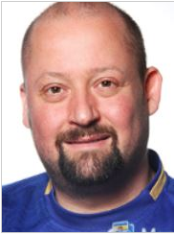
Presentation af Rasmus and Niels
Who are we?
Martin
Mat and Physic
engineer
Rasmus
Arctic engineer
Mat and Physic
Civil engineer

Slide 3
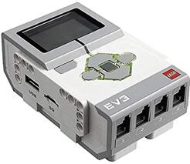
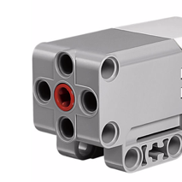
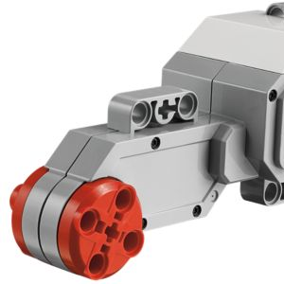
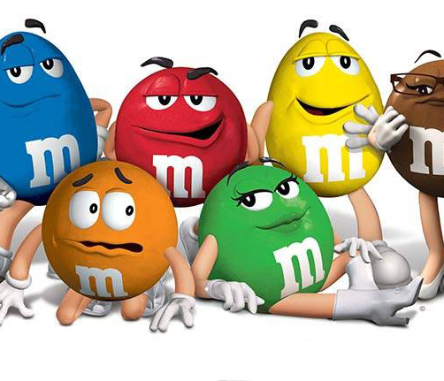
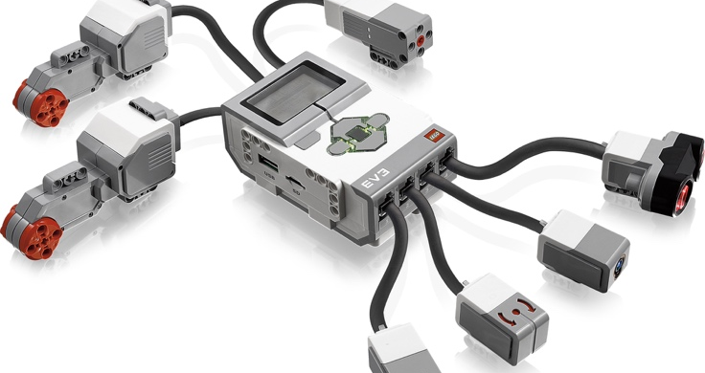
Make a Machine That Sorts M&M’s in Colors
Design Briefing
Design, build and programme a robotic system able to:
identify M&M’s by color and
place M&M’s in separate locations.

Slide 4
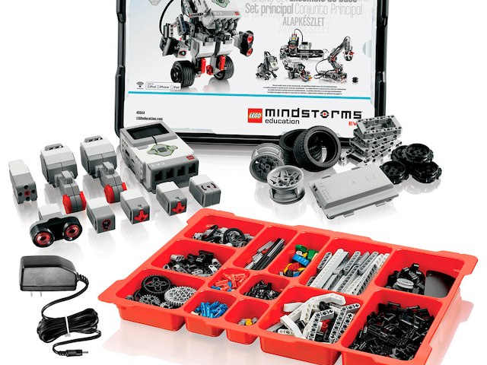
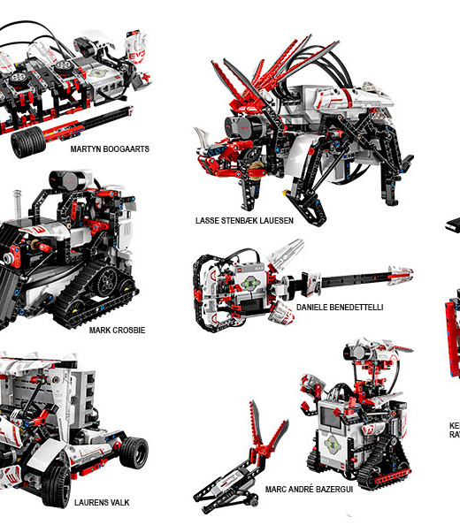
Lego Mindstorm
Why?

Slide 5
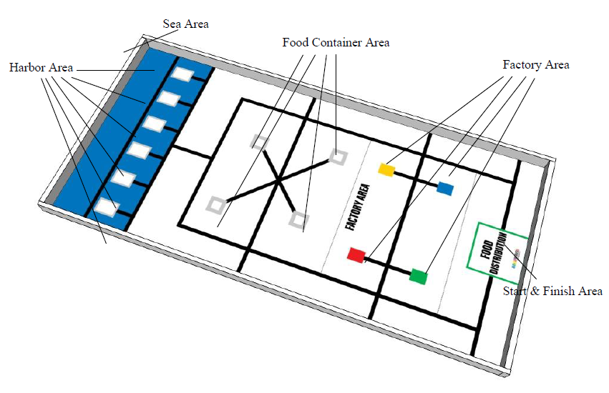

”Regular”
Byg en robot, der kan skiben send af sted på 2 minutter

Slide 6


Slide 7
Index for week 11
Section 1 - learning the basics
Section 2 - The M&M sorting machine
  Part 1 – color sorting
  Part 2 – building a feeding system
  Part 3 – building a distribution system
The competition
The presentation

Slide 8

Section 1 - learning the basics
Finished at 13:00 today

Slide 9
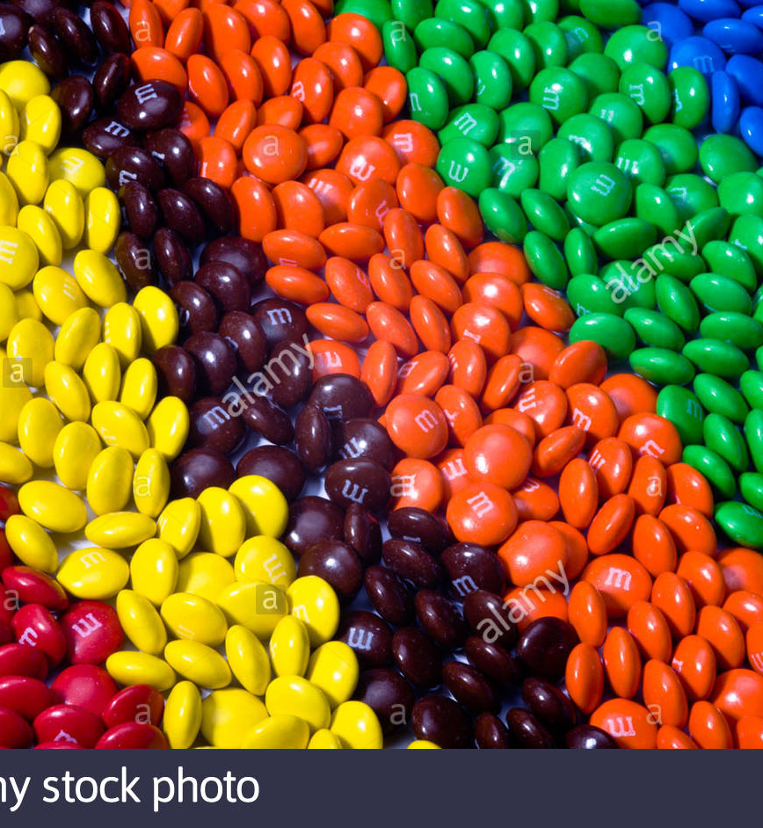
Section 2 - The M&M sorting machine
Part 1 – color sorting
  Finished at Tuesday 8:30
Part 2 – building a feeding system
  Finished at Wednesday 8:30
Part 3 – building a distribution system
  Finished at Thursday 8:00

Slide 10

The competition
This challenge will of course have a competition.
The points will be awarded after each presentation
They're up to 70 points to get in the competition.
the teacher decides how many points you get :)

Slide 11
Points
There's up to 10 points to get for the number of M&M's sorted in a minute
There's up to 10 points to get for the accuracy of the Sorting
Is up to 10 points to get for the for the design of the machine
There are also up to10 points for making the Machine unnecessarily complicated
Incorporate two color sensors to make the color measuring more precis (10 Points)
Make the whole thing move so you can sort the different M&Ms by driving to the boxes (10 points)
get it to sort M&Ms peanuts and regular at the same time (10 Points)

Slide 12
The presentation
On Thursday the group shall produce a 7-10 minutes presentation
Present the process of building and developing the machine
  A2 poster with pictures and some text
Show the machine sorting
A video of the machine sorting M&Ms
  QR code on the poster

