Slide 1





History of KNX
1990
+
+
1999
2006
Foundation: 1990
Under the name ‘EIB Association’
1999
Merger with two other associations (Batibus and EHS)
Goals

Slide 2








KNX – International standardization
KNX – a well established technology!
CENELEC
2003: Approval of KNX as EN50090
CEN
2005: Approval of KNX as EN13321-1/2
ISO/IEC
2006: Approval of KNX as ISO/IEC14543-3-1 bis 7
SAC (P.R. China)
2013: Approval of KNX as GB/T 20965
ANSI/ASHRAE
Reference in US ANSI/ASHRAE standard 135

Slide 3
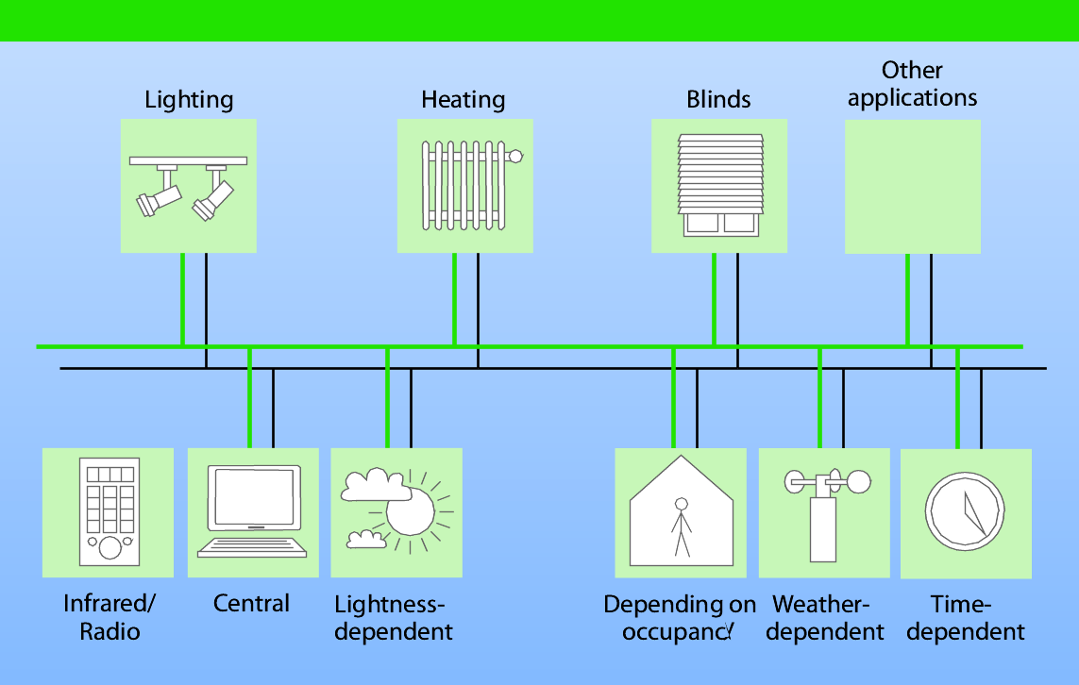
KNX – Introduction to the technology

Slide 4


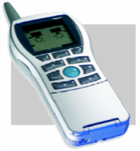
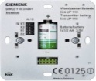

KNX System specification
Common Logo
Objects with standardized
Data Point Types
‘
‘
S
S
’
’
‘
‘
E
E
’
‘
’
‘
S
S
’
’
‘
E
E
’
‘
’
System Mode (PC)
Easy Mode (without PC)
ETS
Extended Protocol
Standard-Protocol
Controller
Push Button
Supported
Media
TP
PL110
RF
IP
Media Coupler
LTE

Slide 5
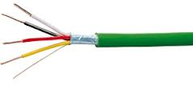
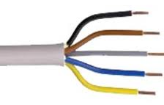


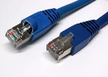
Areas of application for the various media
 | Medium | Transmission via | Preferred areas of application
 | Twisted Pair | Separate control cable | New installations Extensive renovations Highest level of transmission reliability
 | Powerline | Existing network (Neutral conductor must be available ) | If no additional control cable can be installed When 230 V cable is available
 | Radio Frequency | Radio line | When no cables can be installed
 | IP | Ethernet/WIFI | In large installations where a fast backbone is needed For communication with mobile devices

Slide 6

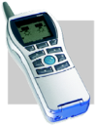

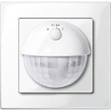
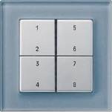
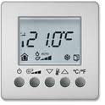
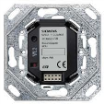
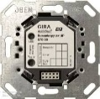
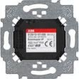




KNX Interworking
Realisation/Installation
of many functions
Standardized configuration
Application software
(in the device or as ETS product data)
Application module
Standardized KNX operating systems
(“Bus Coupling Units”)
Standardized transmission media

Slide 7







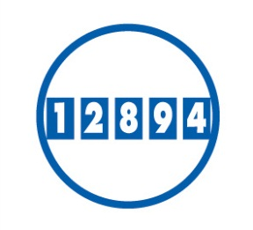


Possible fields of application
Lighting
Blinds & Shutters
Security
Energy Management
HVAC
Monitoring
Remote Control
Metering
Audio/Video Control
White Goods

