Slide 1
Topology - Abbreviations
BC = Backbone coupler
LC = Line coupler
DVC = Bus device
LR = Line repeater
PS/Ch = Power supply with choke
S = Brightness sensor
RC = Routing counter

Slide 2
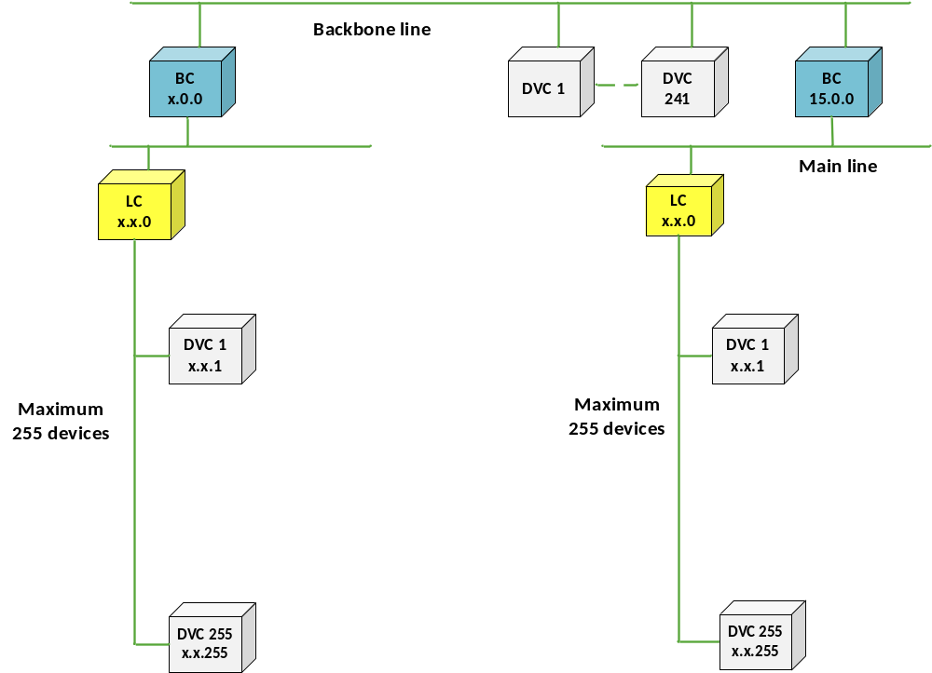
Topology – Overal view

Slide 3
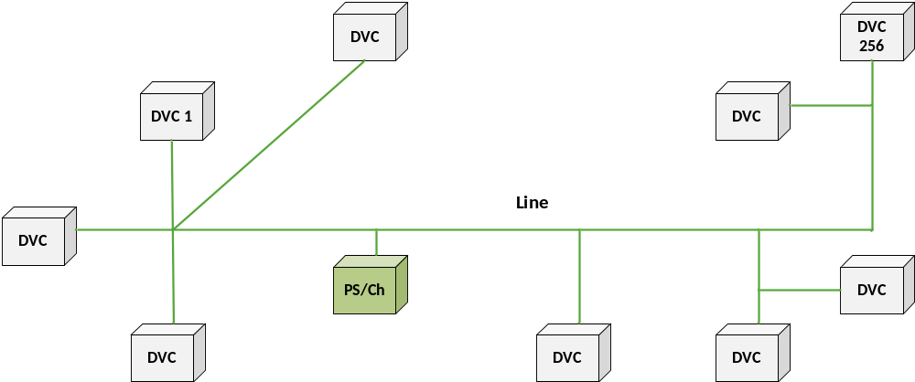
Line

Slide 4
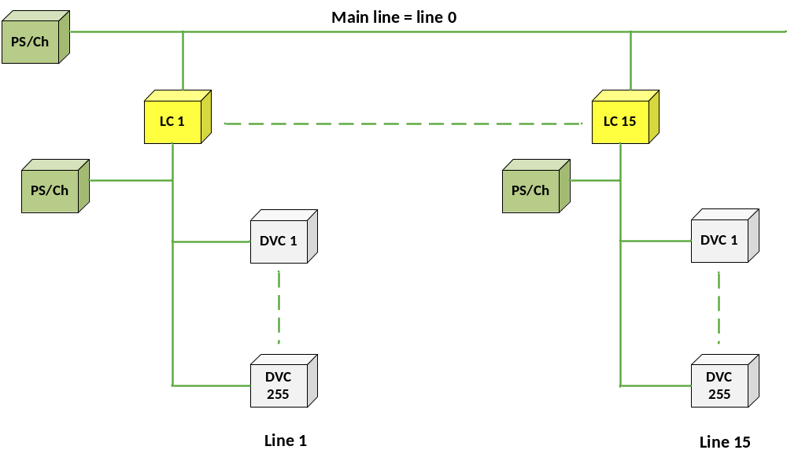
Area

Slide 5
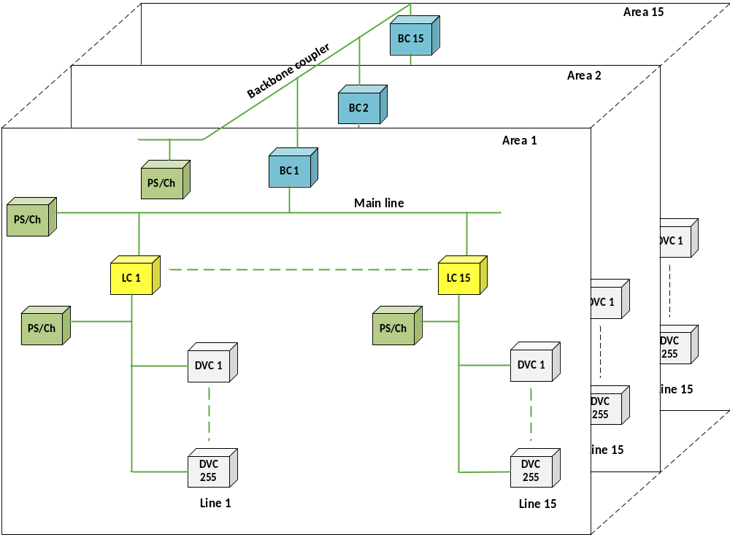
Several areas

Slide 6
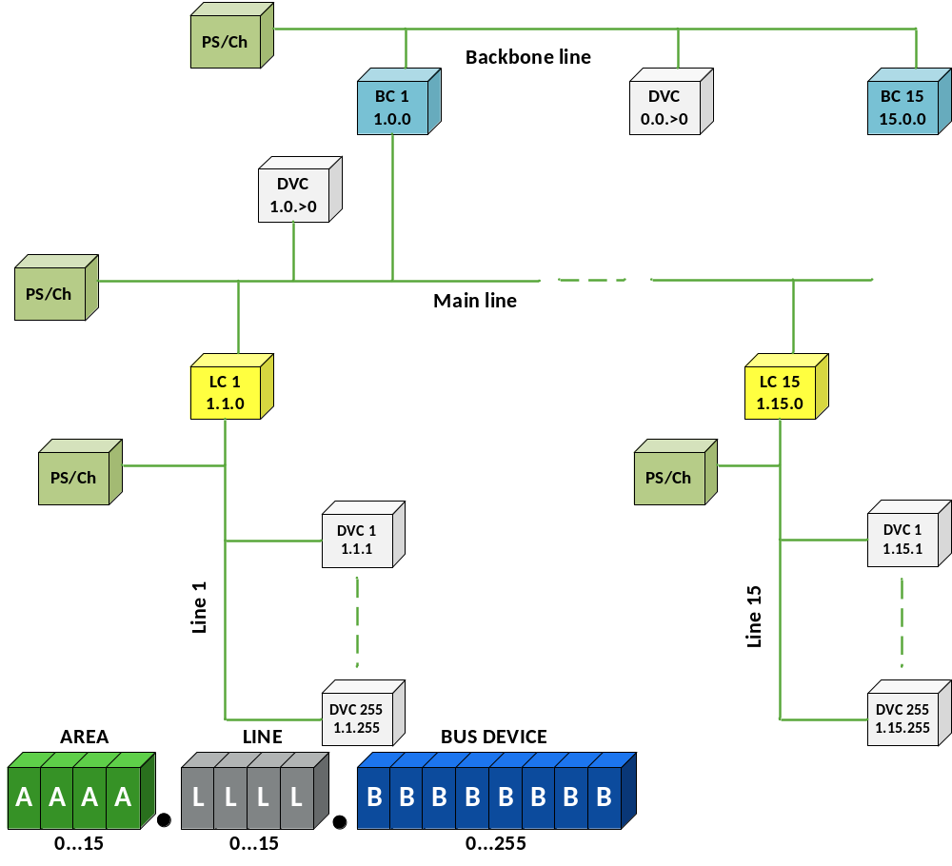
Individual address

Slide 7
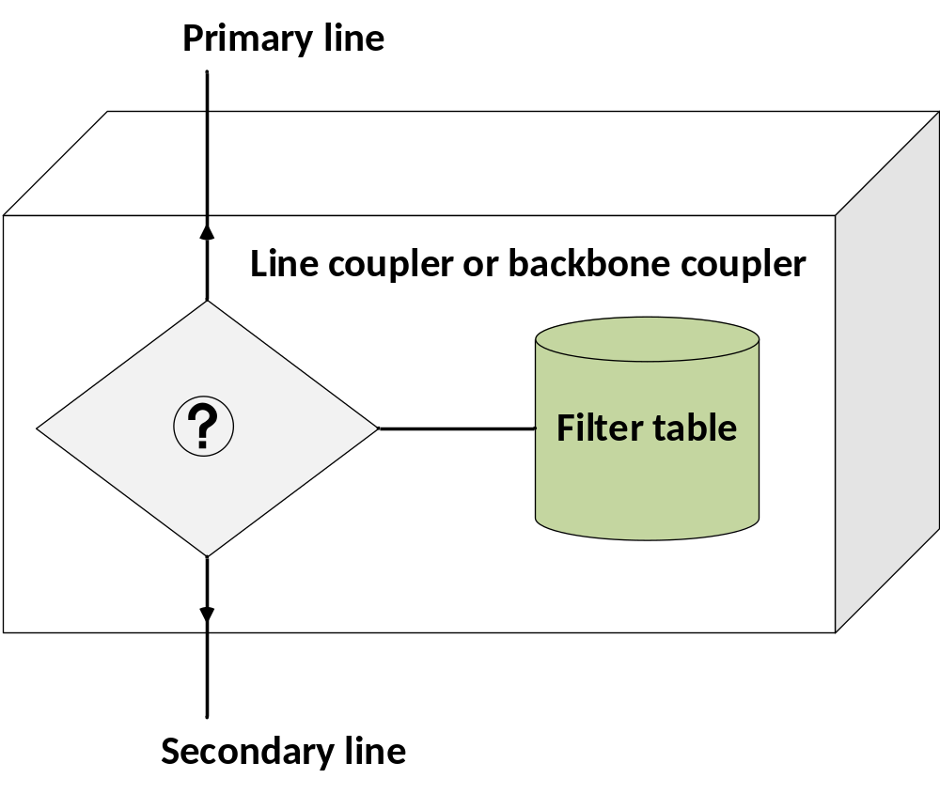
Coupler – gate function

Slide 8
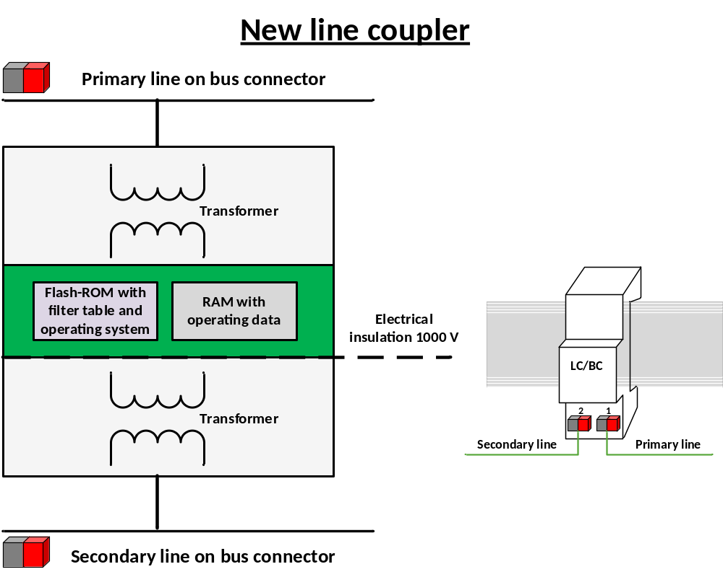
Coupler: Block diagram

Slide 9
Coupler: Fields of application
Individual address
AREA
LINE
BUS DEVICE
A
A
A
A
L
L
L
L
B
B
B
B
B
B
B
B
The coupler is used
as
for
> 0
= 0
= 0
Backbone coupler
Backbone line / Main line
als
> 0
> 0
= 0
Line coupler
Main line / Secondary line
> 0
> 0
> 0
Line repeater
Line extension

Slide 10
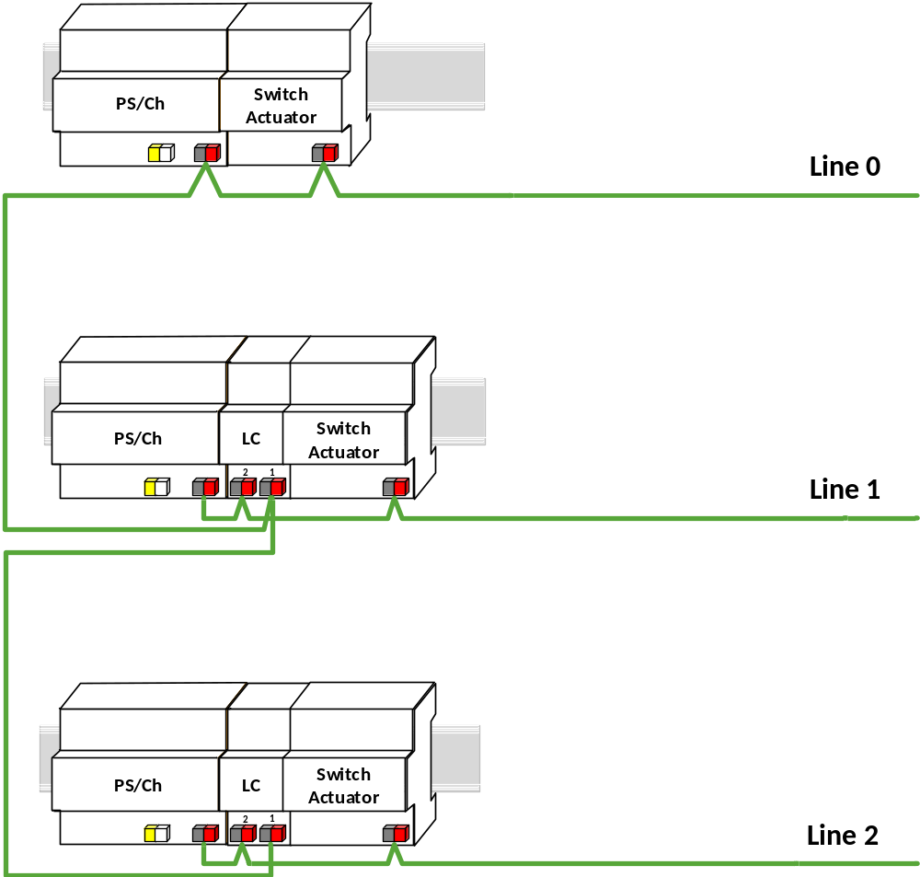
Coupler: Connecting several lines

Slide 11
Example: group addressing
Actuator
L11
L12
L13
L21
L22
L23
Sensors
L11
L21
Group addresses
S1
0/2/11
0/2/11
S1
P1
5/2/66
5/2/66
5/2/66
P2
5/2/67
5/2/67
5/2/67
L12
L22
Main groups:
0 = central functions
5 = e.g. floor 5
Middle groups:
2 = Lighting
L13
L23
P = Push button
L = Lights
S = Brightness sensor
P1
P2

Slide 12
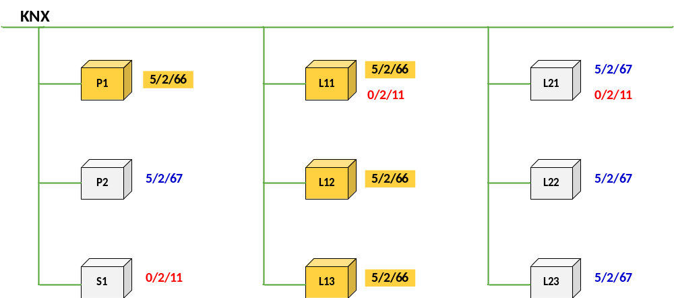
Internal line telegram

Slide 13
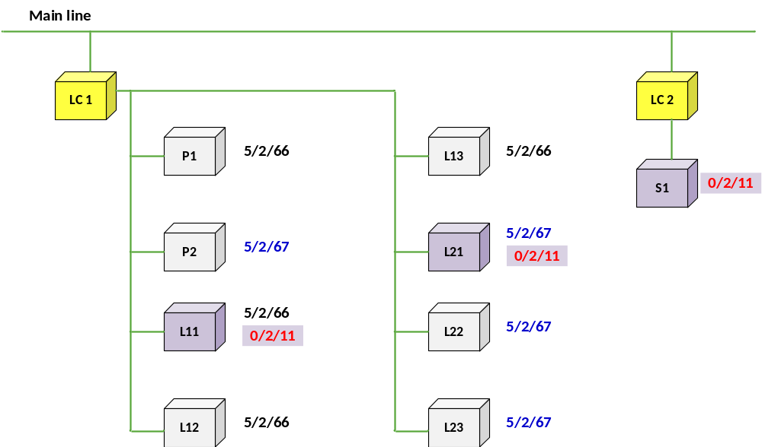
Line-crossing telegram

Slide 14
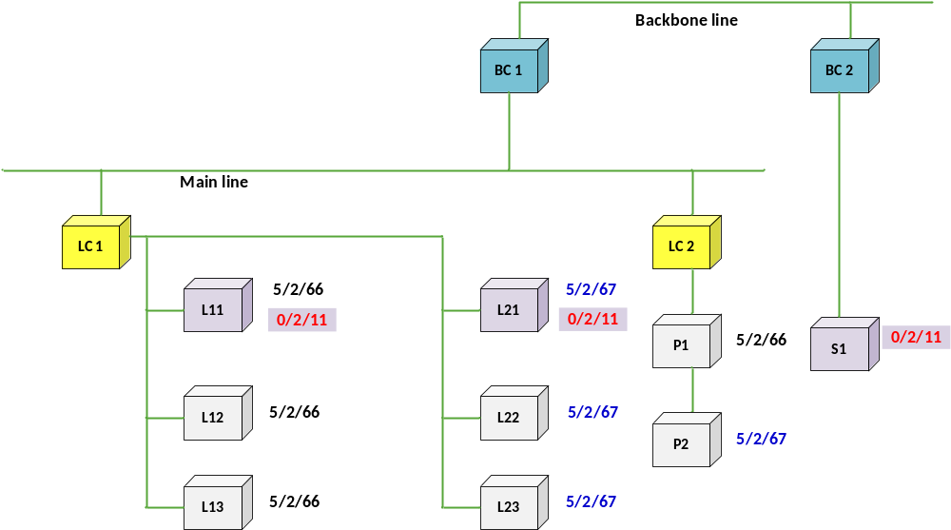
Area-crossing telegram

Slide 15
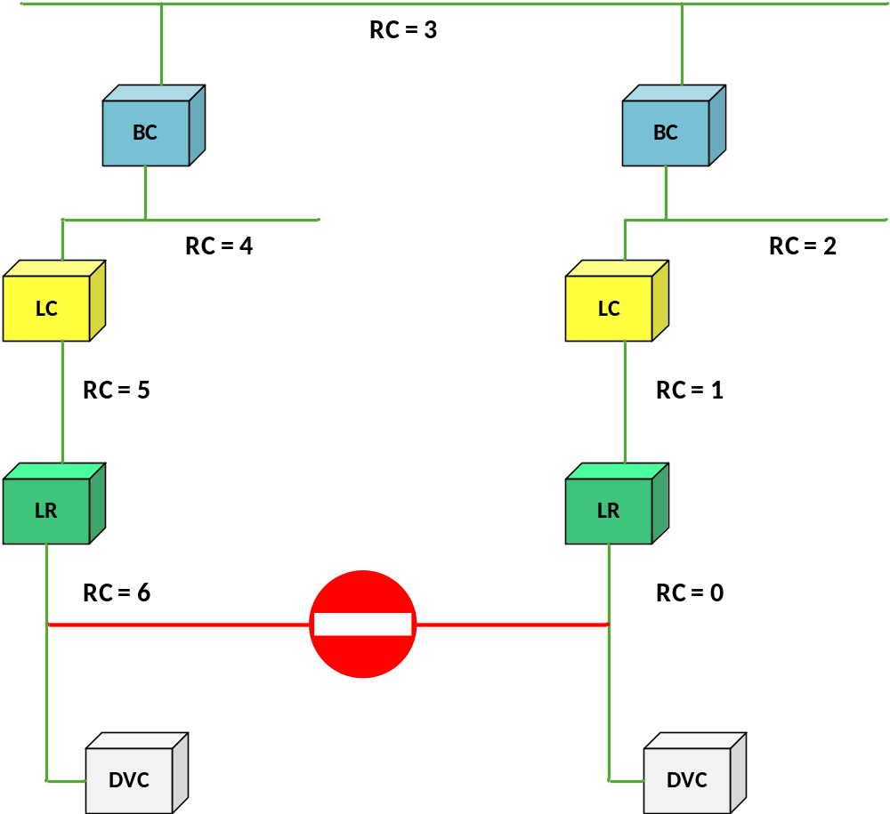
Coupler: Routing counter

Slide 16
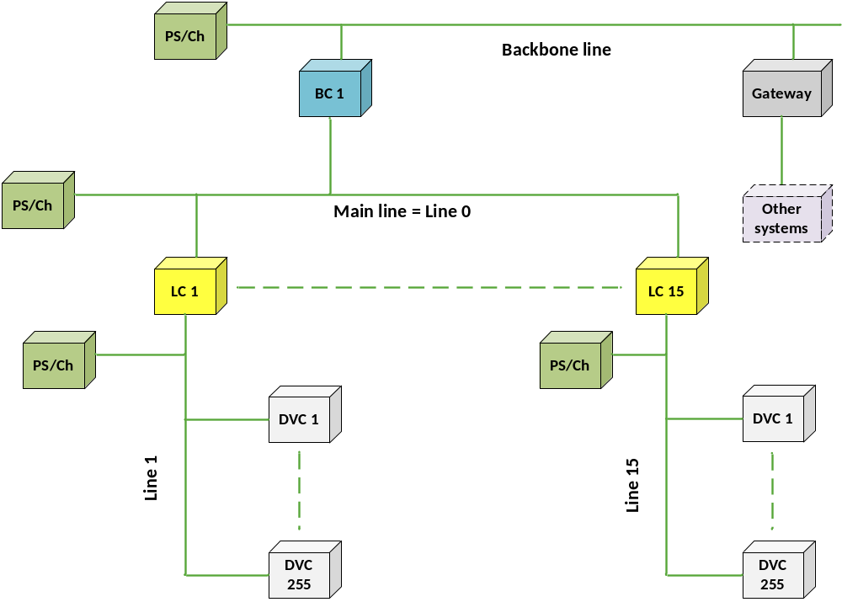
Internal and external interfaces

Slide 17
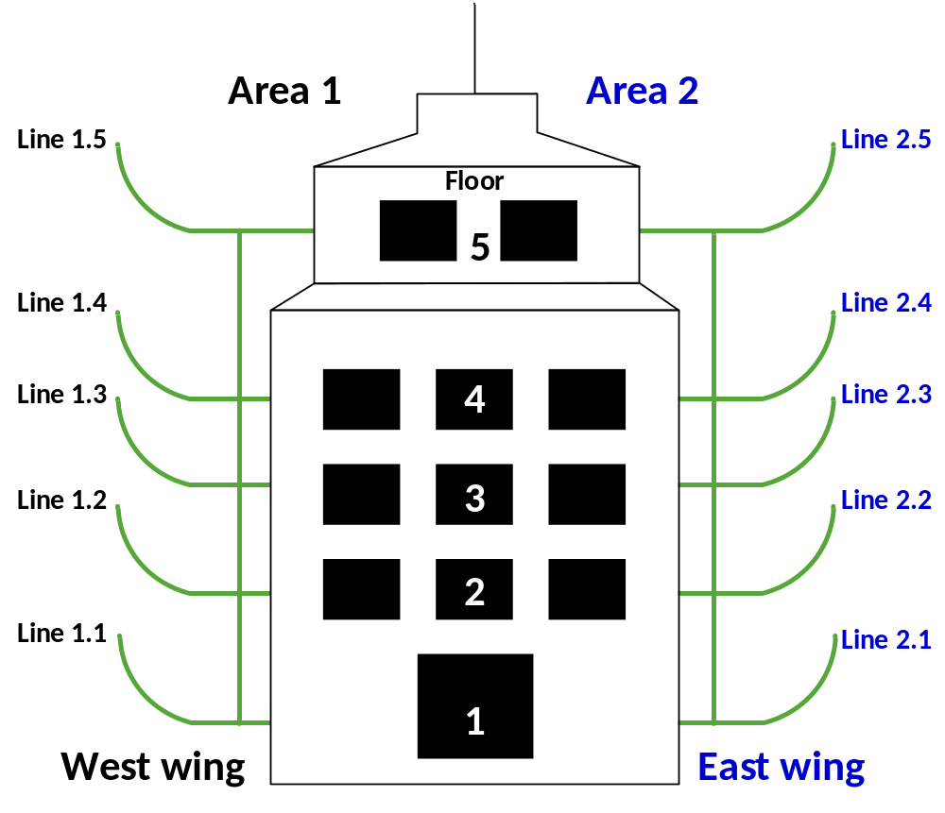
Example: Division of lines in a medium-sized project
Area |  | Line
No. | Comment | No. | Comment
0 | Area 0 | 0 | Backbone line
1 | West wing | 0 | Main line West
 |  | 1 | 1st floor
 |  | 2 | 2nd floor
 |  | 3 | 3rd floor
 |  | 4 | 4th floor
 |  | 5 | 5th floor
2 | East wing | 0 | Main line East
 |  | 1 | 1st floor
 |  | 2 | 2nd floor
 |  | 3 | 3rd floor
 |  | 4 | 4th floor
 |  | 5 | 5th floor

Slide 18
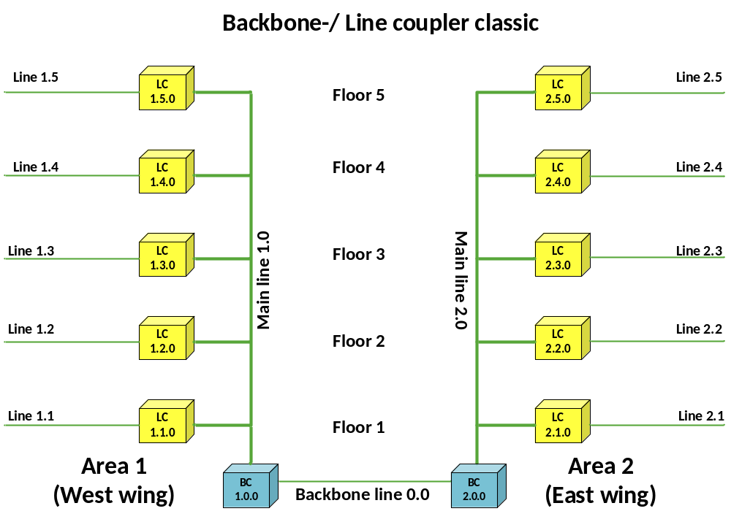
Backbone / Line coupler classical structure

Slide 19
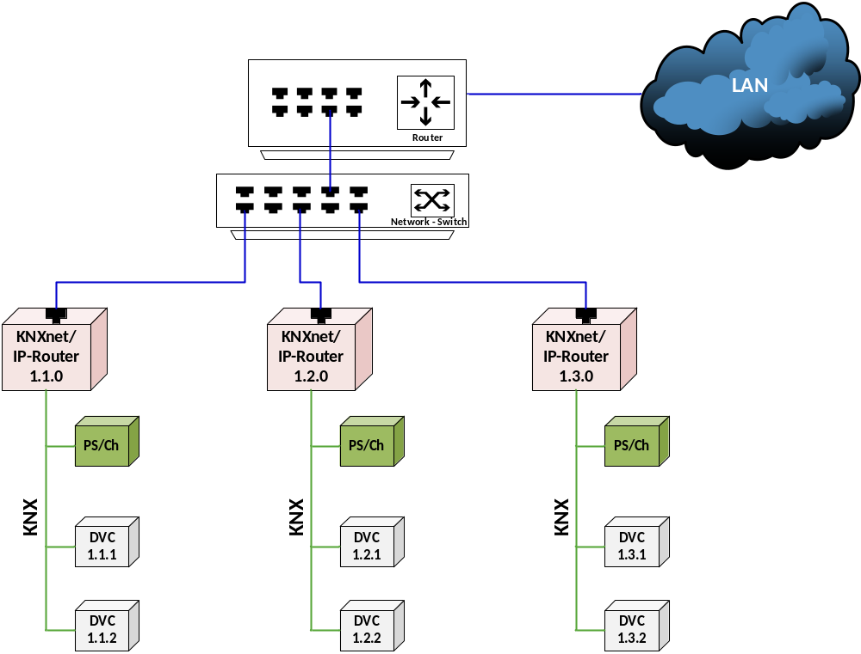
Connecting lines via the LAN network
19

Slide 20
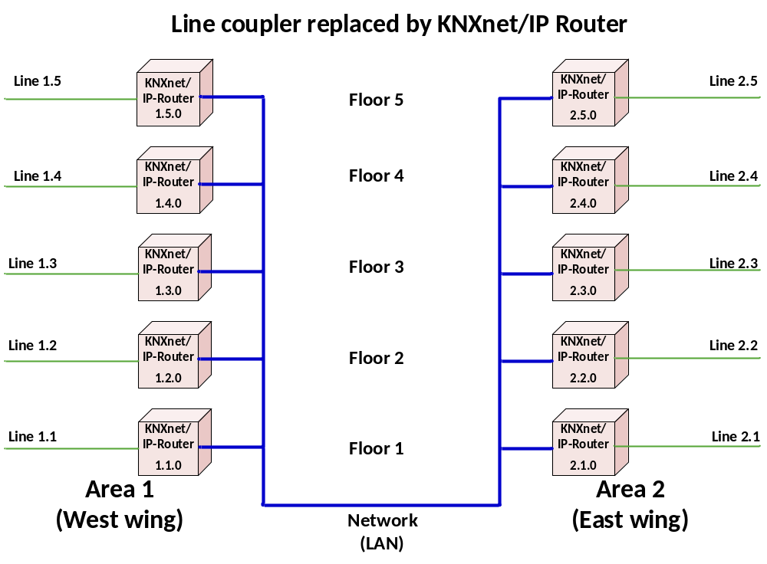
Line coupler replaced by IP Router

Slide 21
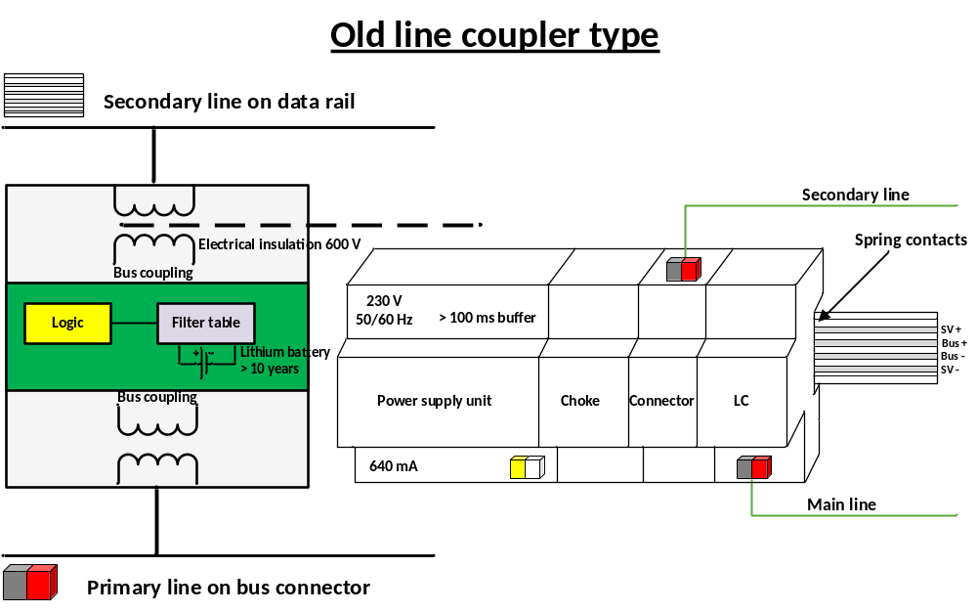
Old line coupler type

