Slide 1
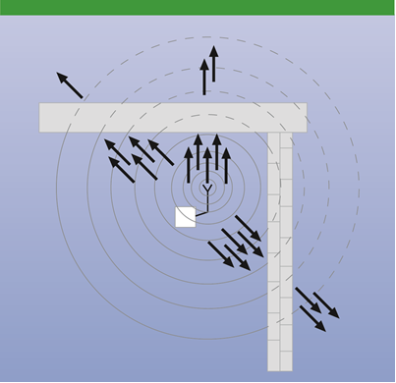
Attenuation by walls and ceilings depending on the material and the wall thickness

Slide 2
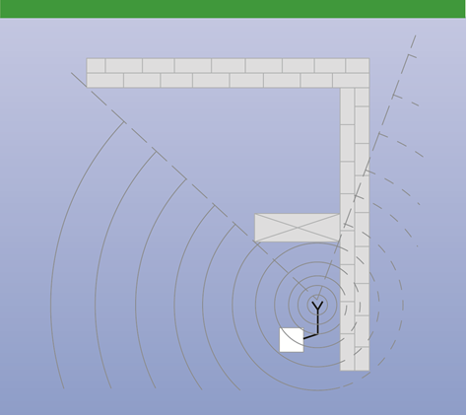
Radio shadows by metal walls, doors or cabinets

Slide 3
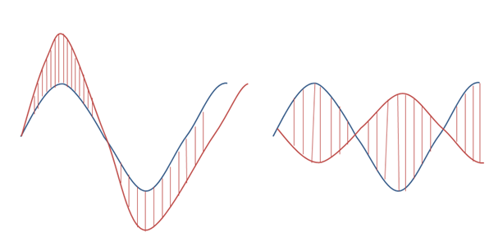
Consequences of reflections
Positive reflection:
signal amplified by reflection
Negative reflection:
signal reversed by reflection

Slide 4
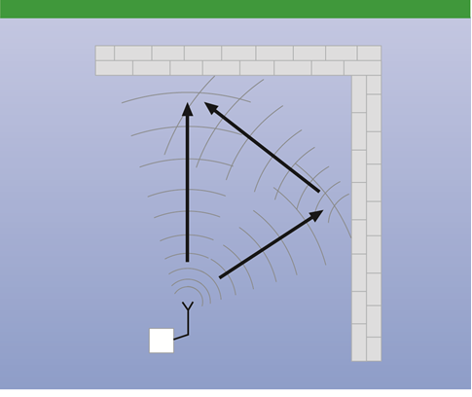
Signal attenuation resp. amplification by reflections

Slide 5
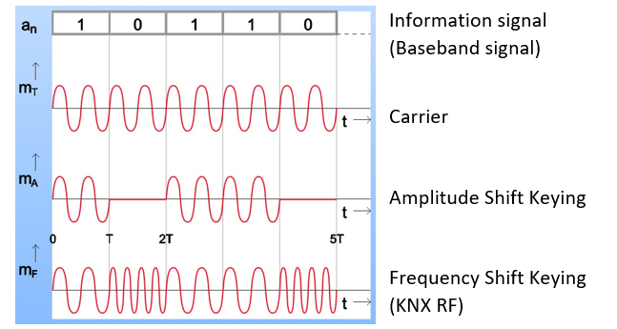
Types of modulation

Slide 6
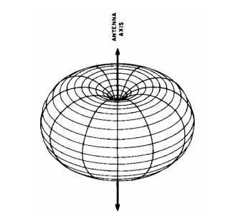
Propagation of radio waves

Slide 7
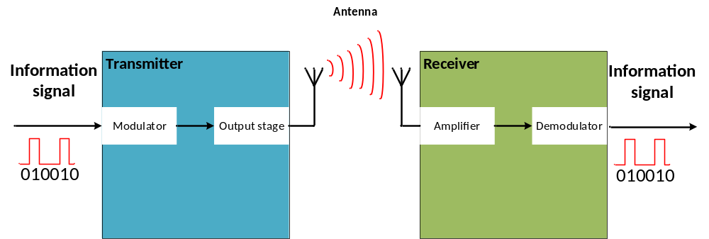
Block diagram of a KNX radio transmission

Slide 8
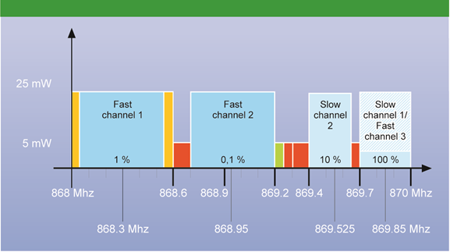
KNX RF-Multi different channels and allocated frequencies

Slide 9
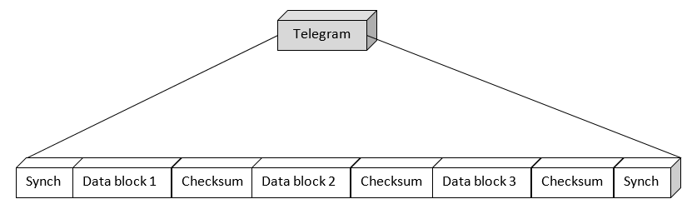
Structure KNX RF telegram

Slide 10
First data block
Data block 1
Control field
KNX serial number or domain address
Checksum

Slide 11
Second data block
Data block 2
Control field
Individual address
Destination address
Control field
Data
Checksum

Slide 12
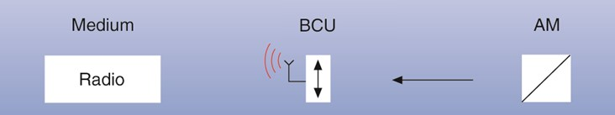
Principle structure of a KNX RF

Slide 13
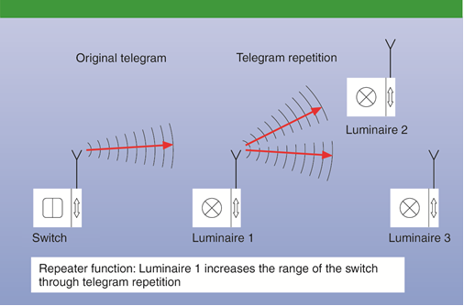
Repeater function in KNX RF

Slide 14
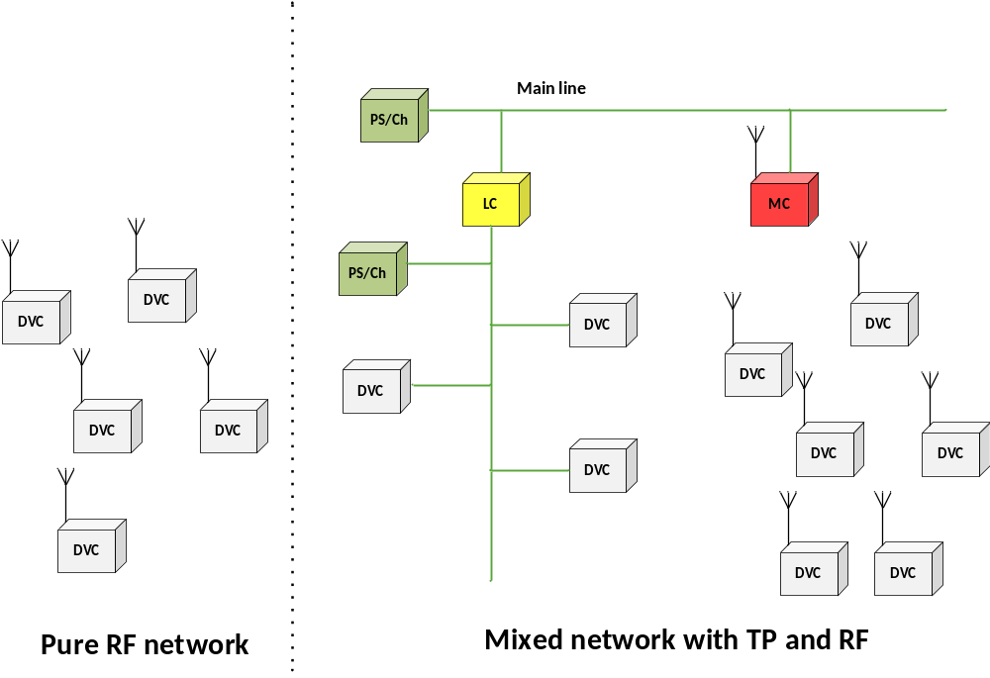
Topology of RF

Slide 15
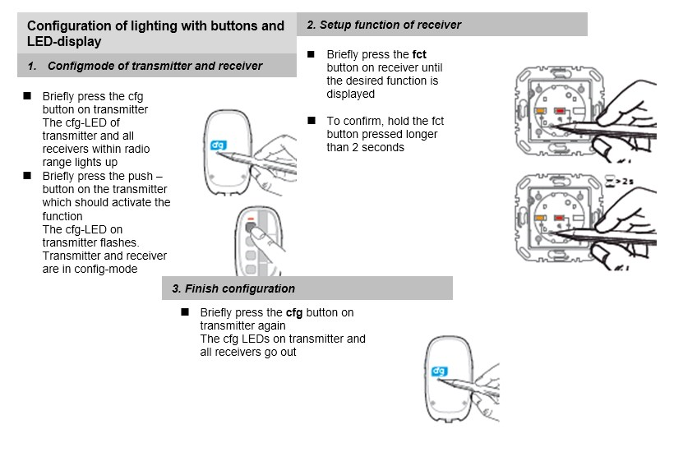
Example for commissioning an Easy Mode Push Button

Slide 16
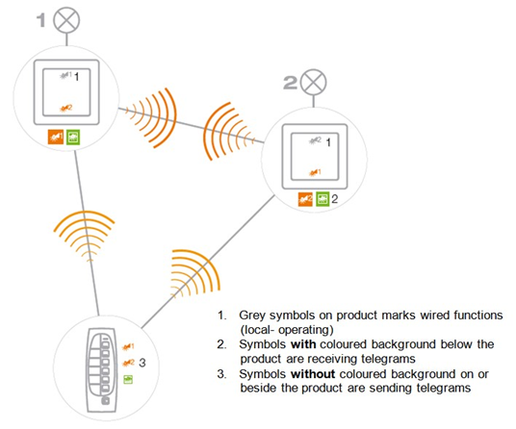
Easy Mode communication

Slide 17
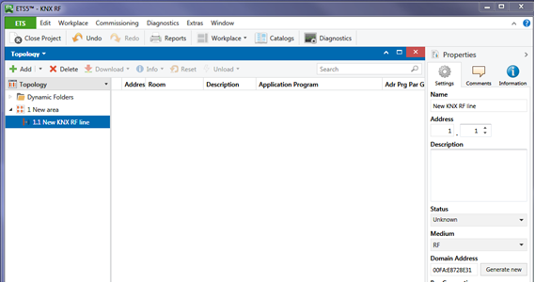
Domain address ETS 5

Slide 18
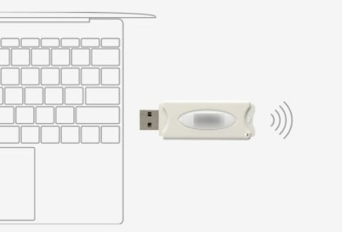
KNX RF data interface

